Slide 1
The Honest Truth About Dishonesty
There’s one way to find out if a man is honest—ask him. If he says “yes,” he is a crook.
–Groucho Marx
Dan Ariely
And it's all in the hands of a lazy projector That forgetting, embellishing, lying machine
--Andrew Bird

Slide 2
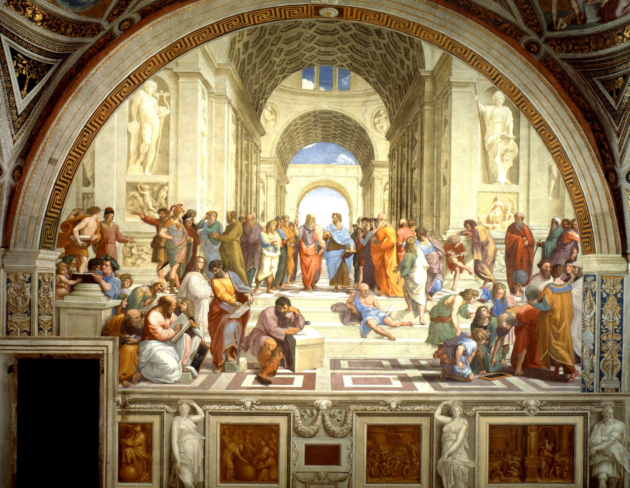
Plato’s “The Ring of Gyges”
Plato’s old brother, Glaucon, and Socrates are discussing justice and Glaucon gives the following example: A shepherd named Gyges finds an invisibility ring. Immediately, he slips it on and heads to court where he seduces the queen and convinces her to help him kill the king, and thereafter takes over the kingdom.

Slide 3
Plato’s “The Ring of Gyges”
For all men believe in their hearts that injustice is far more profitable to the individual than justice, and he who argues as I have been supposing, will say that they are right. If you could imagine any one obtaining this power of becoming invisible, and never doing any wrong or touching what was another's, he would be thought by the lookers-on to be a most wretched idiot, although they would praise him to one another's faces, and keep up appearances with one another from a fear that they too might suffer injustice.— Plato's Republic, (Jowett trans.)

Slide 4
Dan Weiss at the John F. Kennedy Center for Performing Arts
Ira Glass, This American Life
Why?

Slide 5
Descriptive and Prescrptive Program
In addition to exploring the forces that shape dishonesty, one of the main pratical benefits of the behavioral economics approach is that it shows us the internal and environmental influences on behavior.
Once we more clearly understand the forces that really drive us, we discover that we are not helpless in the face of our human follies (dishonesty included), that we can restructure our environment, and that by doing so we can achieve better behaviors and outcomes.

Slide 6
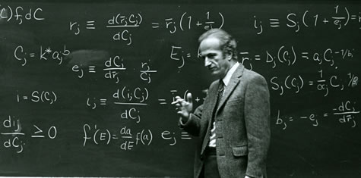
SMORC: Simple Model of Rational Crime
Everyone is a Utiliatrian:
Descriptive claim: We all conduct a cost/benefit analysis using three basic variables: (1) the benefit that one stands to gain from the crime; (2) the probability of getting caught; and (3) the expected punishment if one is caught.
Prescriptive claim: There are two ways to curb cheating/crime. First, increase the probability of being caught (e.g. more police, cameras, etc). Second, increase the magnitude of punishment (e.g. longer prison sentences, bigger fines, etc.)
Gary Becker, Chicago School of Economics
Nobel Laureate,

Slide 7
Two Testable Implications of SMORC:
1. The higher the benefit, the more
likely somone is to cheat (e.g. more
money means more cheating.)
2. The higher the cost, the less likely
someone is to cheat (e.g. higher chance of getting caught means less cheating.)

Slide 8
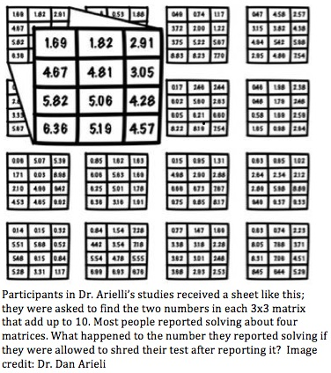
Testing SMORC: The Matrix Task
Shreders reported 6 correct answers as opposed to the 4 correct answers reported by those who could not shred.

Slide 9
Does making it easier to cheat mean more cheating?
After running variations of the matrix task in which it was even easier to cheat (e.g. there was no proctor and subjects would just pay themselves from a bowl) the rate of cheating was the same.

Slide 10
Does increasing the reward mean more cheating?
After raising the reward from $00.50 to $1 $2 $5 $10 the rate of cheating was still the same.

Slide 11
Fudge Factor Theory: Two Opposing Factors
1) Ego Motivation: We want to view ourselves as honest.
2) Profit Motivation: We want as much personal gain as possible (e.g. money, prestige, sex, etc.).
Cheating allows us to have our pie and eat it too, by fudging the truth only a little bit and by practicing rationalization (conscious lying) and self-deception (unconscious lying).
“I knew a young man once, he was a most conscientious fellow and when he took to fly-fishing, he determined never to exaggerate his hauls by more than 25%. ‘When I have caught 40 fish,’ said he, ‘then I will tell people that I have caught 50, and so on. But I will not lie any more than that, because it is sinful to lie.”
--Jerome K. Jerome, 1889

Slide 12
Testing Self-Deception: How Aware Are Subjects of Their Cheating? The IQ Test.
Two groups are given a kind of IQ test. The control is given no opportunity to cheat, while the experimental group is given an answer key. The experimental group is told that the answer key is meant for verification purposes only. Specifically, they are told that the answer key is there so that they could score how well they did on the test and also to help them estimate in general how good they are at answering these types of questions.
The group that had the opportunity to “check their answers” scored a few points higher on average, which suggested that they had used the answer key not only to score themselves but also to improve their performance.

Slide 13
Testing Self-Deception:
First, the experimenters revealed the test scores to the subjects, and then asked the subjects to predict how well they would perform on an IQ test that was similar to but longer. This time neither the control group nor the experimental group would be given an answer key.
Those who had a chance to check their answers (and cheated) started believing that their exaggerated performance was a reflection of true skill, and inflated their predictions.
Second, the same test was administered with an award provided for correct predictions. The same results were produced. The initial cheaters inflated their scores despite loss of potential capital.

Slide 14
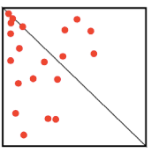
Imagination and the Dot Task
The task: a subject is presented with a
square divided into two triangles by a diagonal line. The trial starts and for one second, twenty randomly scattered dots flash within the square… Then the dots disappear, leaving the subject with an empty square, the diagonal line, and two response buttons, one marked ‘more-on-right’ and the other marked ‘more-on-left.’ Using these two buttons, the task is to indicate whether there were more dots on the right-hand or left-hand side of the diagonal.

Slide 15
Dot Task:
After 100 trials the experimenters know how proficient a subject is at the task.
Next, the experimenter starts the subject off with another 200 trials. This time, though, there’s a catch: the subject is given a monetary reward of ½ a cent every time they press the ‘more-on-right’ button, and a 5 cent reward every time they press the ‘more-on-left’ button, regardless of whether or not their response is correct
Obviously, everyone cheated, but the experimenters wanted to see to what degree a subject’s level of creativity affected their cheating behavior

Slide 16
Subjects who clicked the more-on-right button (the one with the higher payout) more often tended to be the same people who scored higher on the “creativity measures.” Moreover, the difference between more and less creative individuals was most pronounced in the cases where the difference in the number of dots on the right and left sides was relatively small… when the trials were more ambiguous there was more for creativity, cheating.
Ariely found he could induce their subjects to cheat more just by getting them into a more creative frame of mind by way of priming them with words related to creativity. For instance, in one experiment subjects were asked to form sentences from a list of words. While the control subjects were given neutral words such as ‘sky,’ ‘is,’ ‘the,’ ‘why,’ and ‘blue,’ the experimental group were given creativity-related words such as ‘creative,’ ‘original,’ ‘novel,’ ‘imagination,’ ‘ideas,’ etc.

Slide 17
In the Real World
Ariely visited an advertising agency with several different departments, and asked the CEOs of the company to rate how much creativity was required to work in each of the departments. They asked each of the agency’s employees to respond to a series of moral dilemmas: Inflating business expense report, progress reports, stealing office supplies. The level of moral flexibility was correlated with creativity. Designers and copywriters were at the top of the moral flexibility scale, and the accountants at the bottom.

Slide 18
Descriptive claim: The link between creativity and dishonesty is related to people’s ability to tell stories about how they are doing the right thing, even when we are not. The upshot: the more creative we are, the more likely we are to come up with a good story to justify our selfish interests.
Prescriptive claim: We need to better understand the links between creativity and dishonesty and try to restrict the cases in which creative people might be tempted to use their skills to find new ways to cheat.
Hmmm … maybe those old ladies at the JFK performance center were just too creative?

Slide 19
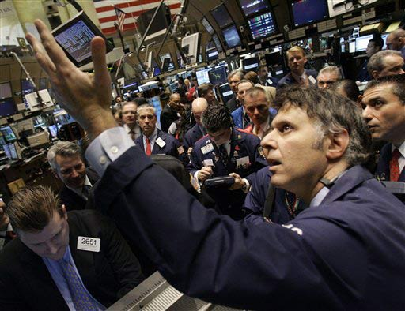
EXTERNAL FACTORS THAT INFLUENCE DISHONEST BEHAVIOR

Slide 20
The Half-Life of Coke: Left some coolers in the dorms. In some there were cokes and in others there were dollar bills. In 72 hrs. all the cokes were gone, but no one took any of the money.
Tokens: In the matrix experiment, when people were awarded plastic tokens they would later exchange for money the probability of cheating went up.
Conclusion: The more removed people are from the actual benefit (in this case money), they are more likely to cheat.

Slide 21
If being one step removed from money liberates people from their moral shackles, what will happen as more and more banking is done online? What will happen to our personal and social morality as financial products become more obscure and less recognizably related to money (think stock options, derivatives, and credit default swaps).

Slide 22
Conflicts of Interest and Honesty Erosion Rationalizing of dishonest behavior increases when two interests are pitted against one another.
Politicians: lobbyists vs. constituents
Doctors: pharmaceutical representatives vs. patients on the other; to
Professors: research vs. teaching

Slide 23

What effect do conflicts of interest have on our honesty? We get a cameo by one of our own “Keeping the illusion of control under control: Ceilings, floors, and imperfect calibration,” with F. Gino and Z. Sharek. Organizational Behavior and Human Decision Processes 114 (2011): 104-114. “Competing to be certain (but wrong): Market dynamics and excessive confidence in judgment” with J. R. Radzevick. Management Science 57 (2011): 93-106. "When Sunlight Fails to Disinfect: Understanding the Perverse Effects of Disclosing Conflicts of Interest," with D. M. Cain and G. Loewenstein. Journal of Consumer Research 37, no. 5 (2010): 836-857. "The Trouble with Overconfidence," with P. J. Healy. Psychological Review 115, no. 2 (2008): 502-517. "Correspondence Bias in Performance Evaluation: Why Grade Inflation Works," with S. A. Swift, Z. S. Sharek, and F. Gino. Personality and Social Psychology Bulletin 36, no. 6 (2010), 843-852.
Don Moore, Haas School of Business

Slide 24
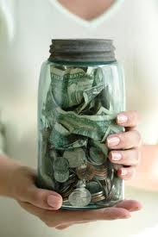
The Jar of MoneyTest The experimenters paired their subjects into teams of two and asked one of the subjects to estimate the amount of money contained in a large jar (the estimator) and the other subject to advise their partner (the advisor). Sort of like you know, a hedgefund maybe… The estimator was given little information about how much money might be in the jar, while the adviser was given a general range (e.g. $15-$30) and was given time to inspect the jar. In the control condition, both the estimator and the adviser were rewarded according to how accurately the estimator guessed the amount of money in the jar. In the experimental condition, the more the estimator over guessed the correct amount, the more the advisor made. In the control condition, the advisers suggested an average of $16.50, while in the conflict-of-interest condition, the advisers suggested an estimate that was over $20.

Slide 25
Contemporary Art and the Cheating Brain
In this experiment, subjects evaluated 60 paintings from 2 art galleries: Third Moon and Lone Wolfe. Half of the subjects were told that their involvement in the experiment had been generously paid for by Third Moon while the other half were told that their involvement had been paid for by Lone Wolf.
When the subjects were presented with the paintings, each piece contained a symbol in the top left-hand corner indicating from which gallery the piece had come.
Result: Participants gave more favourable ratings to the paintings that came from their sponsoring gallery.

Slide 26
During the experiment the subjects were placed inside a brain scanner while they were making their evaluations, which revealed that the part of the brain related to pleasure lit up more when the subjects viewed pieces containing the logo of their sponsor gallery.
Suggesting that favoritism was happening at an unconscious level; when subjects were asked if they thought that the sponsor’s logo had any effect on their art preferences, they all answered: No.

Slide 27
Cheater’s Revenge: People Cheat More When They Think They’ve Been Wronged Control Group: An actor approaches patrons in a coffee shop and asks them to perform a quick 5 minute test in return for $5 (the test involved picking out identical, adjacent letters from a package of 10 pages full of random letters). At the end of the test, the actor handed the subject a stack of bills and a receipt and asked them to count the money, sign the receipt, and leave it on the table. Meanwhile, Daniel went off to find another subject. Here’s the thing, though: the stack of bills contained $9, as opposed to the $5 originally promised.
Experimental group: In this case, when the actor was explaining the procedure to the subject, he was interrupted by his cell phone, took the call, and had a conversation about a date in the evening. The whole fake conversation took about twelve seconds. After the actor slipped the phone back into his pocket, he made no reference to the disruption and simply continued describing the task. Result: 45 % of the controls returned the extra money, while only 14 % of the exerimentals did so.

Slide 28
Conclusion: It is easier to make a story rationalizing cheating if we tell ourselves that we’re not doing anything wrong, we are only getting even. We might even take this rationalization a step further and tell ourselves that we are simply restoring karma and balance to the world. Good for us, we’re crusading for justice!

Slide 29
The Unfortunate Affair of Dying Grandmothers: Cheating ,Will Power Depletion, and Spending Emotional Capital
If you've taught, you know that around the end of the semester people's grannies start dropping right and left. Ariely writes that about 10% of his students tell him that recently a relative or close friend has died at the end of semester. Mike Adams (a biology professor at Eastern Connecticut State University) showed that grandmothers are 10 times more likely to die before a midterm and 19 times more likely to die before a final. Moreover, students at risk of failing a class are 50 times more likely to experience tragic death of their beloved grandmother during finals week. From a public health standpoint it is clear that grandmothers should be closely monitored during finals week.

Slide 30
Cheating and Will Power Depletion, Spending Emotional Capital
Each of the decisions we make to avoid temptation takes some degree of effort (like lifting a weight once), and we exhaust our willpower by using it over and over (like lifting a weight over and over).
This means that after a long day of saying “no” to various and sundry temptations, our capacity for resisting them diminishes. Also, spending emotional capital and depleting will power can occur for any number of reasons and cognitive tasks.
There are lots of experiments that corroborate. For instance, when people are asked to remember an eight digit number they’re more likely to succumb to eating cheesecake than when they’re asked to remember a two digit number. In Ariely’s take on this classic experiment, he did variations of the Matrix Task, and gave different groups cognitive tasks of varying difficulty.
You can guess what the outcome was.

Slide 31
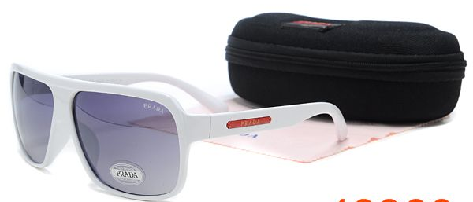
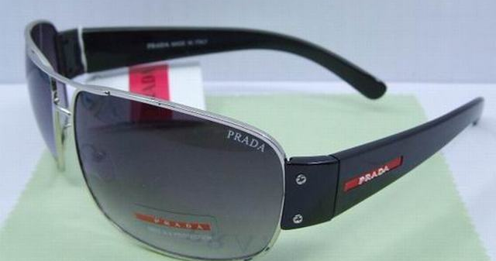
The Devil Wears Prada Knockoffs: A Lesson from Fashion

Slide 32
Fashion is usually referred to as external signaling. From Roman sumptuary laws that dictated who could wear what to the Bible to today's explicit and implicit dress codes the whole system is set up to send a specific social signal and breaking the rules of the signaling game can still get you thrown into jail (e.g. impersonating an officer). And people who buy fakes, mess with the signaling game. They're cheating.

Slide 33
Self-Signaling: If memory serves us, then who owns the master How do we know who's projecting this reel
How does signaling and the feedback loop of self-signaling work. What is the relationship between what we wear and how we behave and think of ourselves and others. Despite what we think, we don't have a very clear notion of who we are. We generally believe that we have a privileged view of our own preferences and character, but in reality we don't know ourselves that well (and definitely not as well as we think we do. Instead, we observe ourselves in the same way we observe and judge the actions of other people−inferring who we are and what we like from our actions. One typical example of self-signaling is charity. You give a beggar a dollar or even better take him to a decent restaurant, buy him a meal, and listen to his story. Walla, your practically a saint in your own eyes. The same applies to fashion. Wearing a real Prada bag does have an effect on your behavior−you are authentically privileged, and knowledgeable about design, etc. But does wearing a knockoff have the same effect? Could it even have a negative effect?

Slide 34
Ariely contacted his friend at Bazaar and in a few weeks he received a package with 20 Chloe bags and 20 pairs of sunglasses, estimated value $47,000. They enlisted a group of female MBA students for their study. Each woman was assigned to one of three conditions: authentic, fake, or no information. Each woman was given same authentic Chloe sunglasses. However, the first group was told they were real, the second that they were fake, and the third was given no information. Then they sent them out into the bright fresh world of the spring Harvard Campus. When the women came back Ariely subjected them to the matrix test.
Result: Only 30% of the participants who thought they were wearing authentic glasses reported scores higher than they usually had while 74% of the ones who thought they were wearing fakes inflated their scores more than they usually had.

Slide 35
To answer the question Ariely turned to the non-information group in which 42% of the women cheated, and it was much closer to the positive self-signaling number. The conclusion then seems to be that negative self-signaling is actually more harmful, than the benefit of positive self-signaling.
Prescriptive claim: Don’t trust people who wear knockoffs…

Slide 36
Cheating Contagion and Bias
Another Matrix test: This time an actor got up just after one minute of testing,
went to the front, announced he’d solved all 20 matrices, and collected his money
in front of all the other subjects.
Of course, cheating increased.
An Interesting Variation: In Berkeley it would go something like this. The subjects
(presumably all Berkeley students) are given the task, and the actor stands up
and ostentatiously cheats. If the actor is wearing a Berkeley sweatshirt, people are
more likely to cheat, as in the previous case. But if the actor is wearing a Stanford
sweatshirt, the subjects still cheat, but about 40% less than in the Berkeley sweater
case, even though the actor is exactly the same.

Slide 37
The Robin Hood Effect: Cheating for Someone Else’s Benefit
Matrix task with partner I: Subjects perform the task with a partner and split the total of the winnings. In this scenario they get to shred in private. If one participant claimed to have earned $4, and the other claimed to have earned $2, they would have earned $6 altogether, and each get $3.
Result: When participants learned that both they and someone else would benefit from their dishonesty if they exaggerated their scores, they ended up engaging in even higher levels of cheating, claiming to have solved 3 more matrices than when they were cheating just for themselves.
Matrix task with partner II: Same task but the money goes to a third party (e.g. cancer research).
Result: Cheating went up even more.
Matrix task with partner III: This time subjects perform the matrix task together but they cannot shred in private.
Result: Cheating was nearly eliminated.

Slide 38
Descriptive Claim: It is easier to rationalize cheating when it is altruistic, and altruism is the oil the keeps the gears of any organization working smoothly.
Prescriptive Claim: There should monitoring where between departments where greater affinity threatens increased cheating.

Slide 39
Final Conclusion:
When thinking about dishonesty and cheating it is important to recognize that we human beings aren’t driven by SMORC. Rather, it would appear that we are driven by the desire to benefit from cheating on the hand, and the desire to think of ourselves as good and honest people on the other. The latter counteracts the former. However, our sophisticated mental machinery allows us to get the best of both worlds (to a degree). Specifically, our capacity for rationalization and self-deception allows us to cheat a little while nonetheless hanging on to the view that we are good people. The more creative we are, the easier it is for us to execute these reality-bending capacities. What’s more, numerous external factors can influence just how easy or hard it is for us to ‘fudge’ things. By identifying these factors, we can limit how much cheating and corruption we see in our own lives, and in society at large.

Slide 40
Questions:
1. Isn’t this just another binary model that essential functions like the utilitarian model? Instead of weighing benefit and punishment, Ariely is balancing benefit and self-image (which is essentially just an internalized “punishment” mechanism).
2. Also, he says very little about what people are thinking i.e. how this “ego motivation” is constructed.
3. What does it even mean to argue with yourself in this way? In the SMORC model we the punishment is externalized. We can literally see it in the legal code, but what is going on under the hood of our skulls, and if this answer isn’t readily available does this undermine his descriptive program, let alone his prescriptive claims?
4. As evidenced by Ariely’s own methodology it seems that it is ok, even good to mislead people at times (e.g. when conducting research on deception). When then is it good and when is it bad to lie? What kind of measuring stick do we use? How much of our conscious and unconscious deception falls into a gray area of neither obviously bad or obsviously good?

